Slide 1
Naming in Computer Systems

Slide 2

Outline
Naming in booting
  Linux booting sequence
  Bus address
  Memory load
  Mmap I/O & DMA

Slide 3
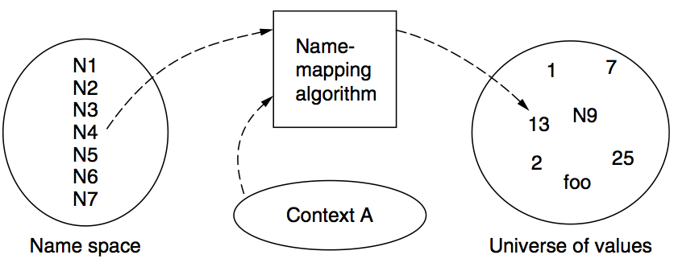
Keep two questions in mind
What is the memory, the interpreter, and the communication link respectively?
What is the name, the context, the name mapping algorithm?

Slide 4


Linux booting: 5 stages
init
User app on Disk
Kernel
Linux on Disk
Stage 2 bootloader
GRUB/LILO on Disk
Stage 1 bootloader
GRUB on MBR (Disk)
System startup
BIOS on Flash

Slide 5
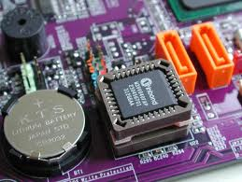
1. BIOS
BIOS’s job
  1st instruction: 0xFFFF0
  POST (Power-On Self Test)
  Manage resource: name space
  Enumerate bus device
  Load boot loader into memory & give control to it
Three abstractions
  Interpreter: CPU, BIOS controller, memory controller
  Memory: flash memory & RAM
  Communication link: system bus

Slide 6
2. Bootloader stage 1 (MBR)
MBR (Master Boot Record)
  First 512-byte on the disk (the first block)
Bootloader stage 1’s job
  Load stage 2 into memory
  & give control to it
Three abstractions
  I: CPU & DC & MC
  M: disk & RAM,
  C: system bus
MBR
Bootloader
512-byte
Partition
Table
Magic num

Slide 7
3. Bootloader stage 2
Bootloader stage 2’s job
  List boot menu
  Load user-selected kernel into memory
  & give control to it
Three abstractions
  I: CPU & DC & MC,
  M: disk & RAM,
  C: system bus

Slide 8
4. Kernel
Kernel’s job
  Change CPU to protected mode
  Initialize system…
  Load init into memory and run it
Three abstractions
  I: CPU & DC & MC,
  M: disk & RAM,
  C: system bus

Slide 9
5. init
init process
  The first user space program, pid=1
  The root & parent of all other processes
init’s job
  Run /etc/rc.d/rc.sysinit
    Start system processes in /etc/inittab
    Start multiple “getty” which waits for console logins
Three abstractions
  I: CPU & DC & MC,
  M: disk & RAM,
  C: system bus

Slide 10
Booting sequence
Three abstractions
  Interpreter: CPU, memory controller, disk controller
  Memory: BIOS’s flash memory, RAM, disk
  Communication link: System bus
Common patterns
  Processor read from memory (LOAD) and interpret
    Memory cell naming: bus address
  I/O devices transfer data to memory
    Disk sector naming: block number
    DMA & Memory-mapped I/O

Slide 11
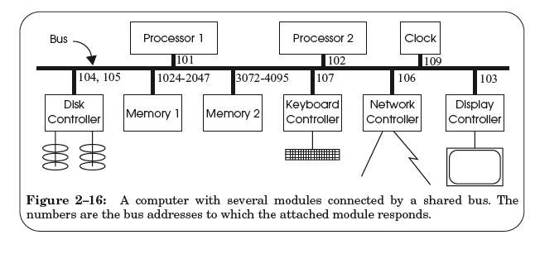
2.3 A hardware layer: the bus

Slide 12
Bus as the communication link: SEND message
Bus feature
  A set of wires: comprising addr, data, control lines that connect to a bus interface on each module
  Bus arbitration protocol
    Bus arbiter (optional): a circuit to choose which modules can use the bus
  Broadcast link: every module hears every message
    Bus address: identify the intended recipient

Slide 13
Bus address
Bus address space (physical address)
  Each module has its own bus address range
  BIOS is in charge of managing at booting time
  1MB in the past, 4GB today, larger in the future
  Basic unit: byte
Each module examines the bus address field
  For every message
  Ignores those not intended for it
  What about sniffering?

Slide 14
Split-transaction
Source module requires exclusive use of the bus
Source module places a bus address of the destine module on the bus
Source module signals READY wire to alert the other module
The destine module singles ACKNOWLEDGE wire after copied the data
  If synchronized, then READY & ACKNOWLEDGE are not needed, just check the address lines on each clock cycle
Source module releases the bus

Slide 15
Memory load example: LOAD 1742, R1
Processor #2 => all bus modules: {1742, READ, 102}
2号处理器发信号控制总线-->我要去1742地址读取，我是102.被解码后，对应单元就从高阻状态(看上去联通，实际上不连通)变成低阻状态连通。

Slide 16
Memory load example: LOAD 1742, R1
Memory1 recognizes the address is within its range
  By examining just a few high-order address bits

Slide 17
Memory load example: LOAD 1742, R1
Memory1 acknowledges and processor2 releases the bus
Memory1 performs the internal operation to get the value
  value <- READ (1742)

Slide 18
Memory load example: LOAD 1742, R1
Memory1 => all bus modules: {102, value}

Slide 19
Memory load example: LOAD 1742, R1
Processor2 is waiting for this result, just copies the data on the bus to its register R1

Slide 20
Memory load example: LOAD 1742, R1
Processor2 acknowledges and memory1 releases the bus

Slide 21
I/O modules as interpreters
Keyboard controller
  Interprets keystrokes
  Places the result in memory
Disk controller: interpreter of disk I/O programs
  Mapping disk addresses to track and sector number
  Moving data from the disk to the memory

Slide 22
Example: keyboard
When user depresses a key, keyboard SENDs a message to the processor containing the key value
As the processor is not ready, its bus interface will:
  copies the data into a temporary register,
  acknowledges the keyboard,
  SENDs an interrupt signal to the processor

Slide 23
Example: keyboard
The processor handles the interrupt in next cycle
  SENDs the value over the bus to memory module
Suitable for slow device, not suitable for disk

Slide 24
DMA
DMA (Direct Memory Access)
  A processor SENDs a request to a disk controller to READ a block of data
    Including the address of a buffer in memory
  The disk SENDs the data directly to memory
    Incrementing the memory address appropriately

Slide 25
DMA
Benefits of DMA
  Relieve the CPU’s load to execute other program
  Reduce one transfer (original two)
  Take better advantage of long message if the bus supports
  Amortize the overhead of the bus protocol

Slide 26
Memory mapped I/O
Use LOAD and STORE instructions to address the register and buffer of the I/O modules
  Just like access memory
  Address is overloaded name with location info
Provide a uniform interface to bus modules
  MMU translates virtual addr to physical addr
    Physical address is system bus address
  I/O modules translate bus address to register address internally

Slide 27
Memory mapped I/O
Processor
Virtual address
MMU
Physical address (System bus address)
Internally translate
to register address
Memory
Disk
Keyboard

Slide 28

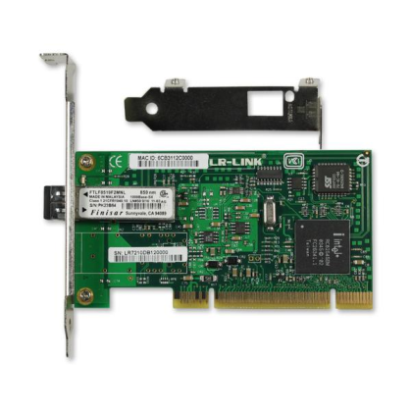
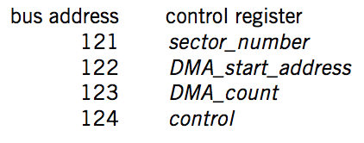
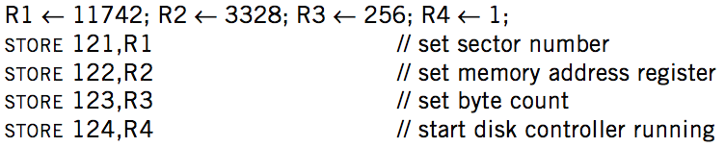

Memory mapped I/O combined with DMA

Slide 29
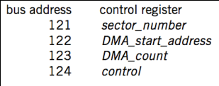
DMA example
Processor 1
Processor 2
101
102
256-511
3072-4095
121-124
BIOS
Memory
Disk
Processor #1 => all bus modules: {121, WRITE, 11742}
  Disk acknowledge and write the value 11742 to its control register
Processor #1 => all bus modules: {122, WRITE, 3328}
Processor #1 => all bus modules: {123, WRITE, 256}
Processor #1 => all bus modules: {124, WRITE, 1}

Slide 30
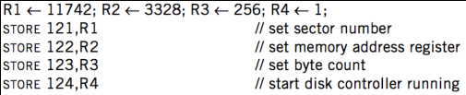
DMA example
Processor 1
Processor 2
101
102
256-511
3072-4095
121-124
BIOS
Memory
Disk
Disk => all bus modules: {3328, WRITE, data[11742]}
  Memory acknowledge and save data[11742]
Disk => all bus modules: {3329, WRITE, data[11743]}
... (loop)
Disk => all bus modules: {3583, WRITE, data[11997]}

Slide 31
DMA example
Processor 1
Processor 2
101
102
256-511
3072-4095
121-124
BIOS
Memory
Disk
When transferring is finished, disk controller SENDs message to the processor
  Just like keyboard controller does when press a key
Processor will enter interrupt handler next cycle
Now the processor knows that the DMA is done

Slide 32
Questions
How does CPU find the 1st instruction on BIOS?
  Hard wire 0xFFFF0 to PC after reset
Why not map the whole disk to memory?
  So that the CPU can access a byte on the disk directly by system bus, but way too slow
People are part of the system. The design should match the user’s experience, expectations, and mental models

